Slide 1
Database & Analytics Programming Project
Submitted by:
Jonathan mendes (x18179584)
Terrance Thomas (x18184928)

Slide 2
Presentation Points
Dataset - About and Why
Project Process Flow
Data and Database
Data Processing
Visualization

Slide 3
Project Process Flow
Datasets
Load into MongoDB
Using Python
Transfer Data
Cleaning process in Python
Data Visualization using Plotly
Merging of Data, View Creation &Data Load in POSTGRESQL
Move data back to python
Processed Data transfer

Slide 4
Dataset - About and Why
Dataset is on YELP
YELP : - Business directory service and crowd-sourced review forum
Users write review → engage through social media features → Piggyback on Search Engine Traffic

Slide 5
Dataset - About and Why
To understand the Restaurants registered on YELP
To help sales team to target areas with less registrations
Understand User review behaviour
To show the popularity of Restaurants in a particular city
To understand which State users reviews

Slide 6
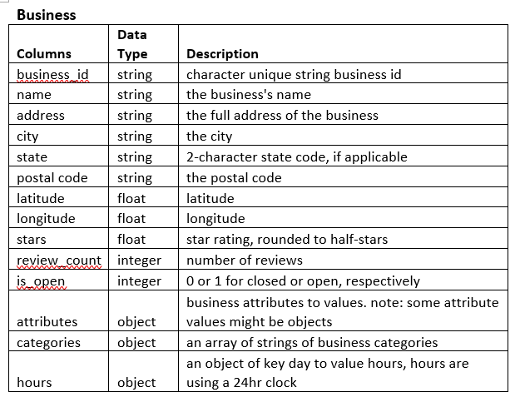
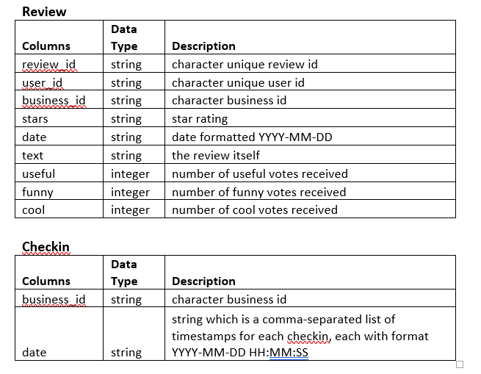
Data and Database

Slide 7

Data and Database
MongoDB - Classified as a NoSQL database program
Datasets – 3(Json files)
Row Count – Business (385218), Checkin(323900),Review(13371800)
Loaded into MongoDB using python
Code Snippet for data transfer: collection_data = mydb["business"] with open('C:\\Users\\Tero\\Desktop\\yelp-dataset\\yelp_academic_dataset_business.json','r',encoding='utf-8') as f: for line1 in f: line1 = json.loads(line1.strip()) collection_data.insert_one(line1)

Slide 8

Data and Database
PostgreSQL - Classified as a Relational database management system
Datasets – 3 (cleaned data)
Row Count – Business (16597), Checkin (16597) and Review(1042659)
3 views created – DAPVisuals (Merging of Business and Checkin), Restaurantwithmax5stars, Statewithmax5stars
Code Snippet for data transfer optimized using chuck size: from sqlalchemy import create_engine engine = create_engine('postgresql://postgres:@Pass123@127.0.0.1:5432/pythonproject1’) dfbusinessFiltered.to_sql('business',engine,if_exists='replace',chunksize=1000)

Slide 9
Data Cleaning
Level 1 – Removed unwanted columns
Level 2 – Removed Null and NA values
Level 3 – Filtered data by Restaurants only
Level 4 –Data Filtered by Restaurants with check-ins only

Slide 10
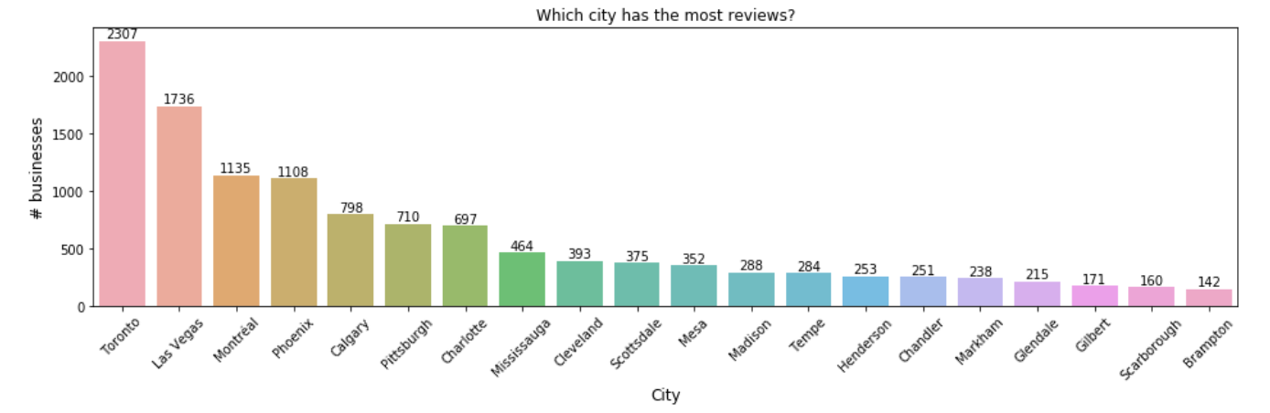
Visualizations City By number of reviews

Slide 11
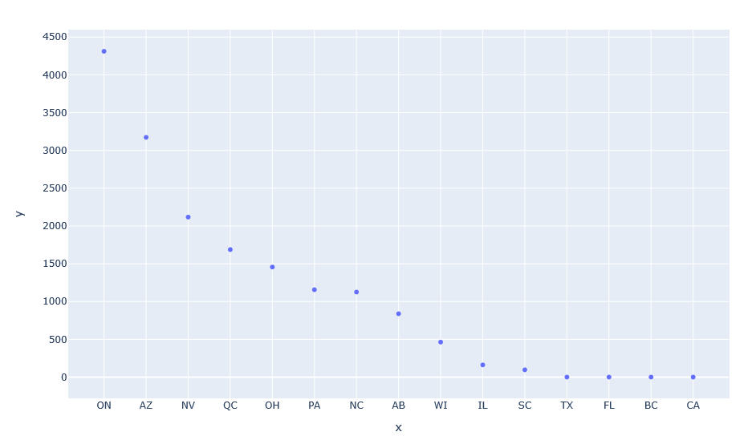
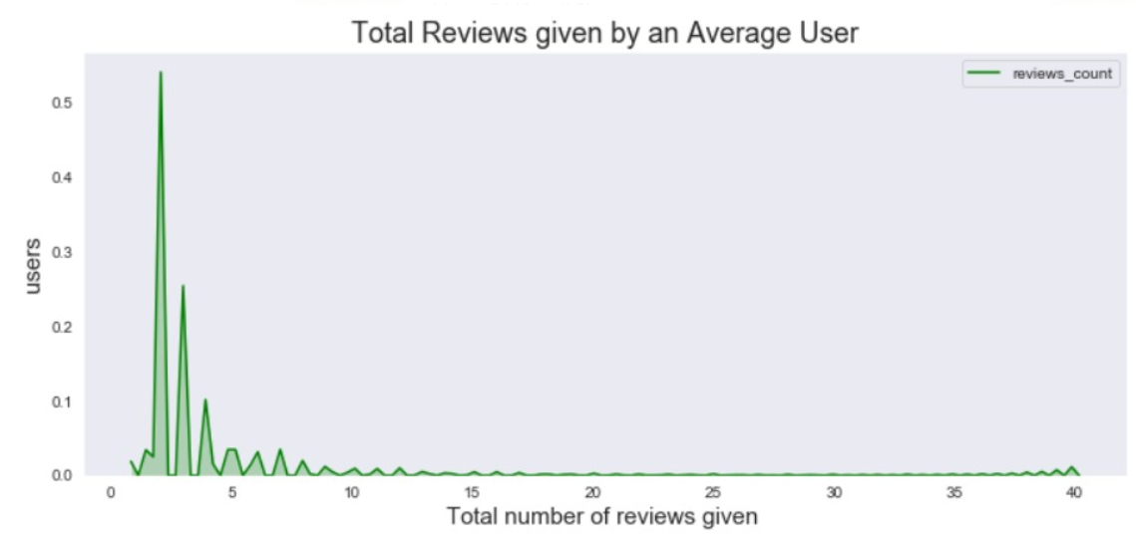
Visualizations
Number of Restaurants by Cities
Average reviews by user

Slide 12
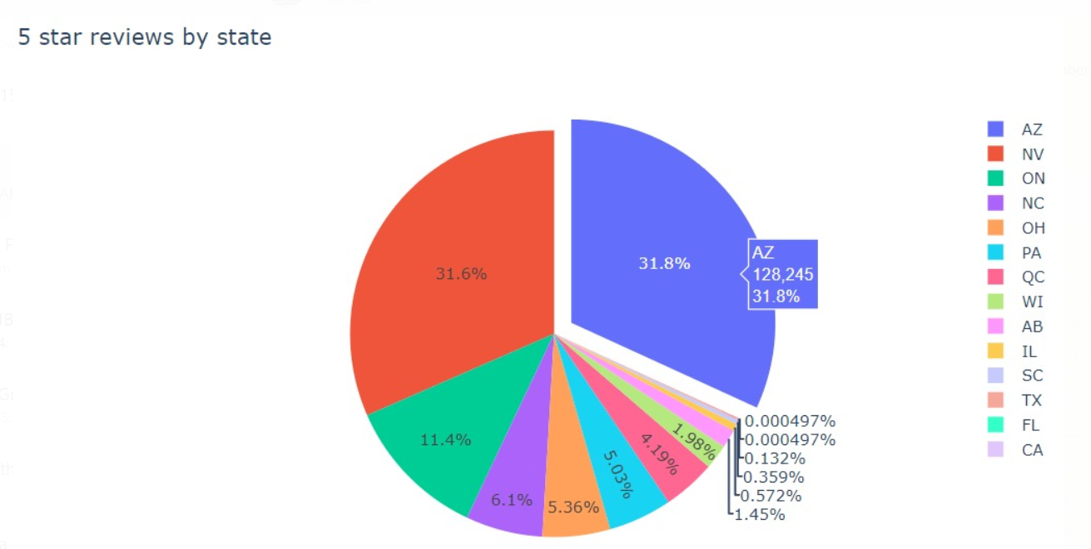
Visualizations State with maximum 5 star reviews

Slide 13
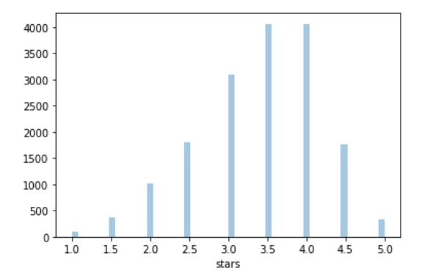
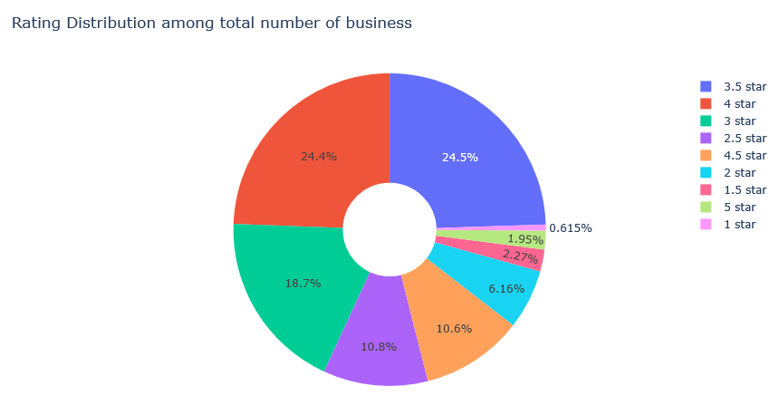
Visualizations Star Rating distribution by restaurants

Slide 14
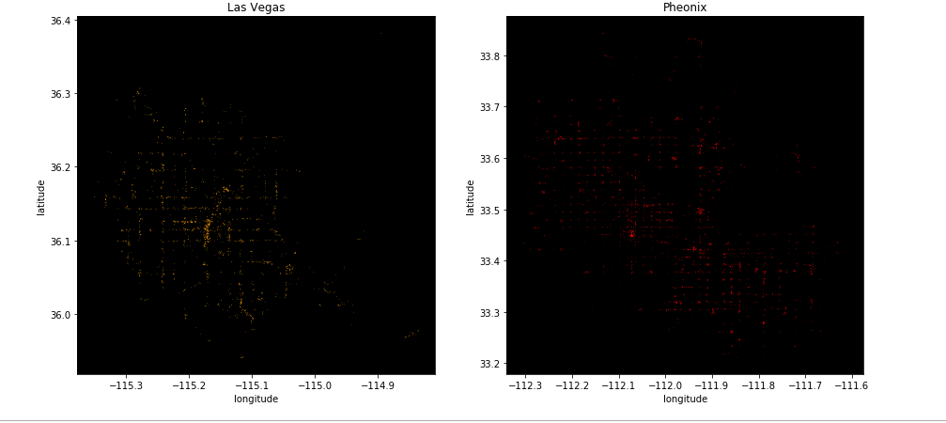
Visualizations City Heatmap by popularity

Slide 15
Thank You

